Slide 1
From the bio lab to the data lab My journey to R coding
Martha Luka
13th Nov 2021

Slide 2
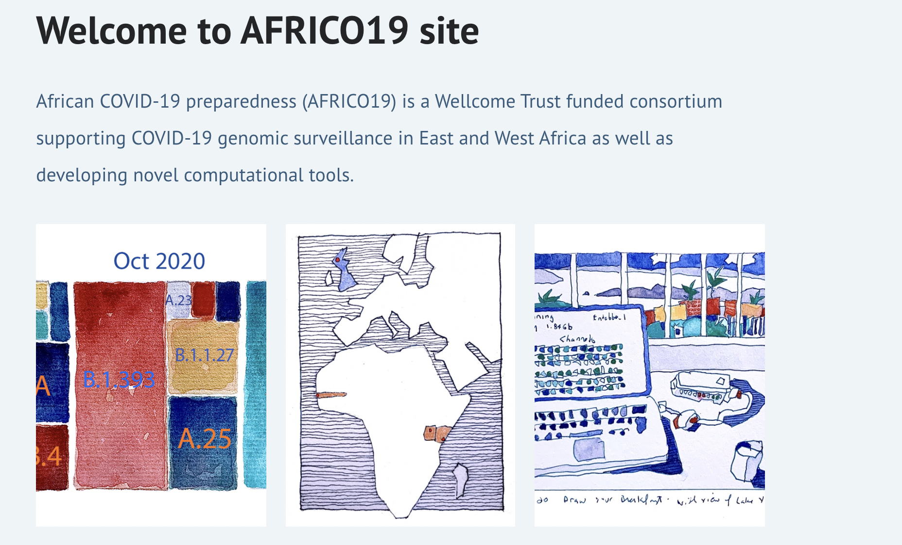





What I do
Funders
https://africo19.wordpress.com

Slide 3



Education
PgD. Health Research Methods,
Pwani University/KWTRP
Dec 2016
Aug 2018
Dec 2020
BSc. Medical Laboratory Science and Technology,
University of Nairobi
MSc. Bioinformatics,
Pwani University/KWTRP

Slide 4





My first work experience
I wanted to do more, yearned for a challenge…
Clinical Laboratory

Slide 5





An opportunity
An opportunity arose
Clinical work
Research

Slide 6
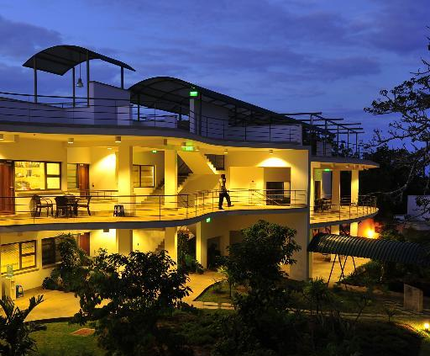
Transition to research
PgD interview in Kilifi
What is R?

Slide 7
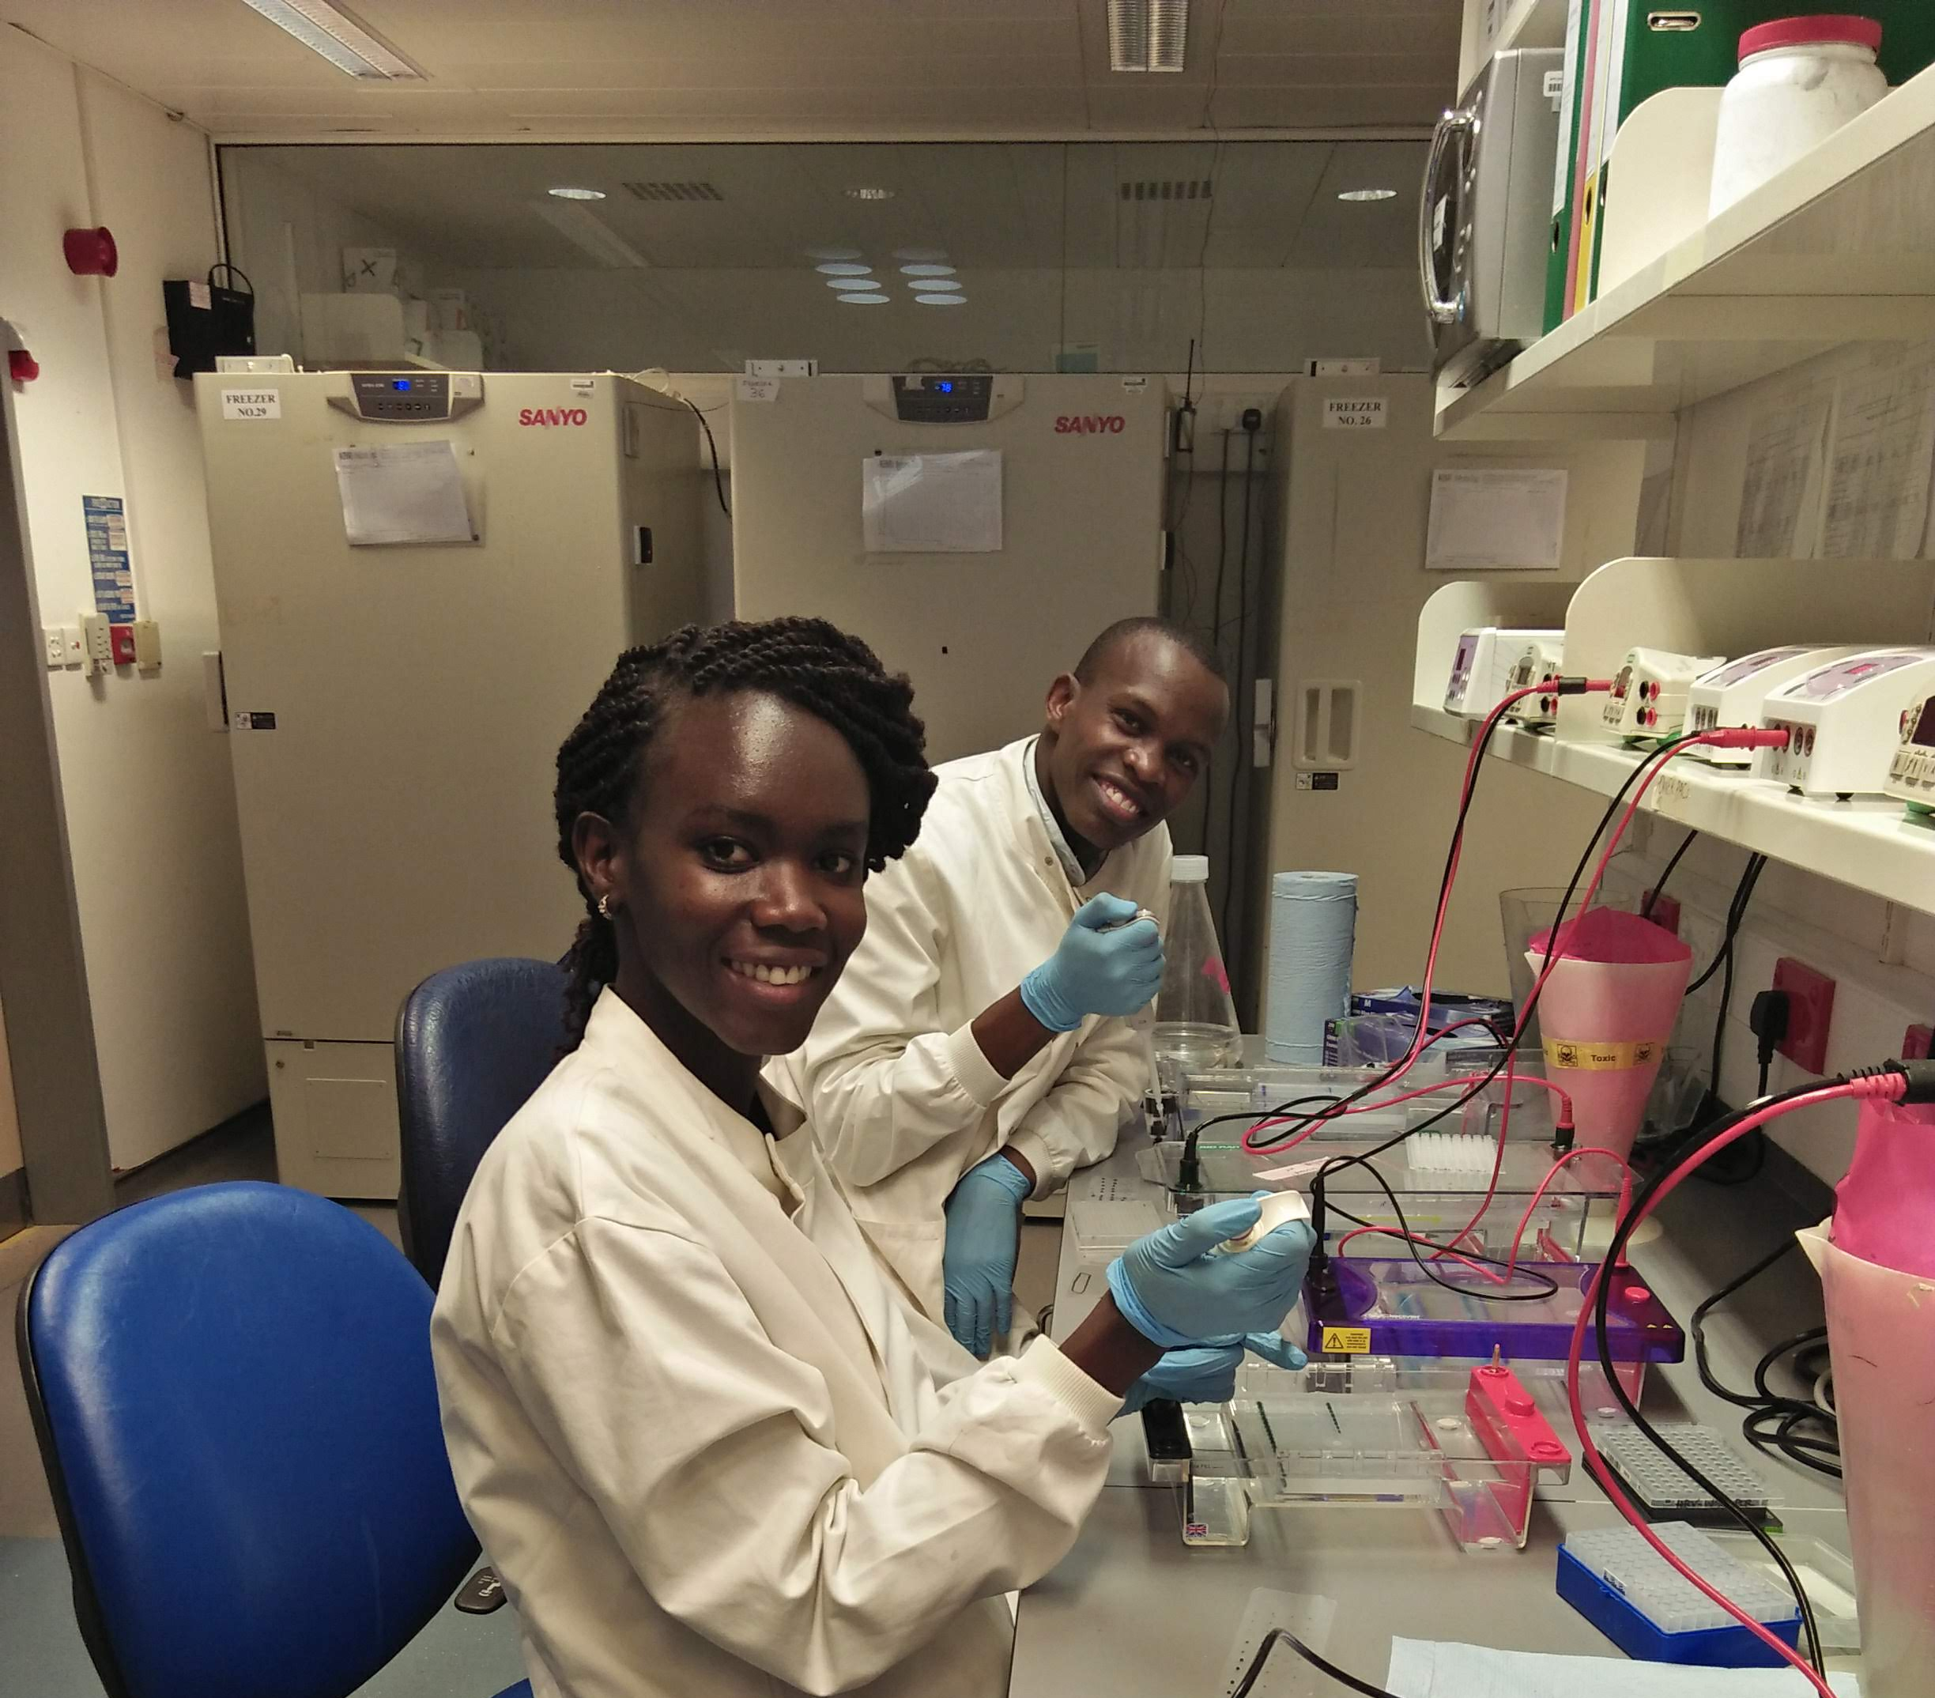
The experience
Molecular techniques to understand respiratory viruses

Slide 8

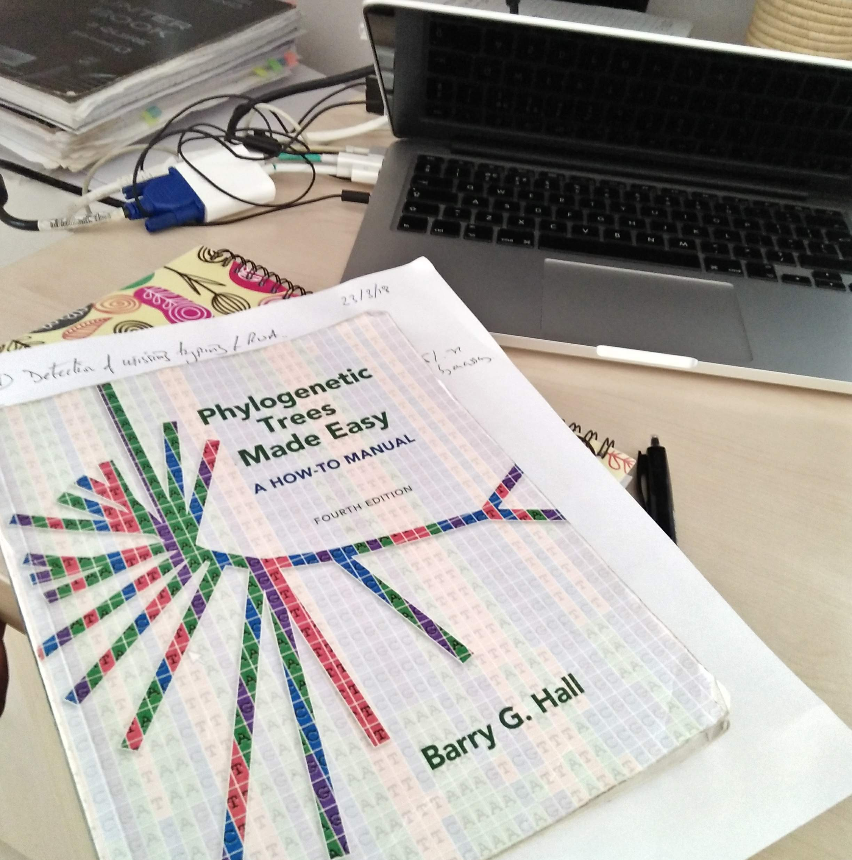
Then came the data …
Data
DNA sequence data
Demographics
Metadata
? Data summary and visualizations
Exposure to data analysis
R, and other tools

Slide 9
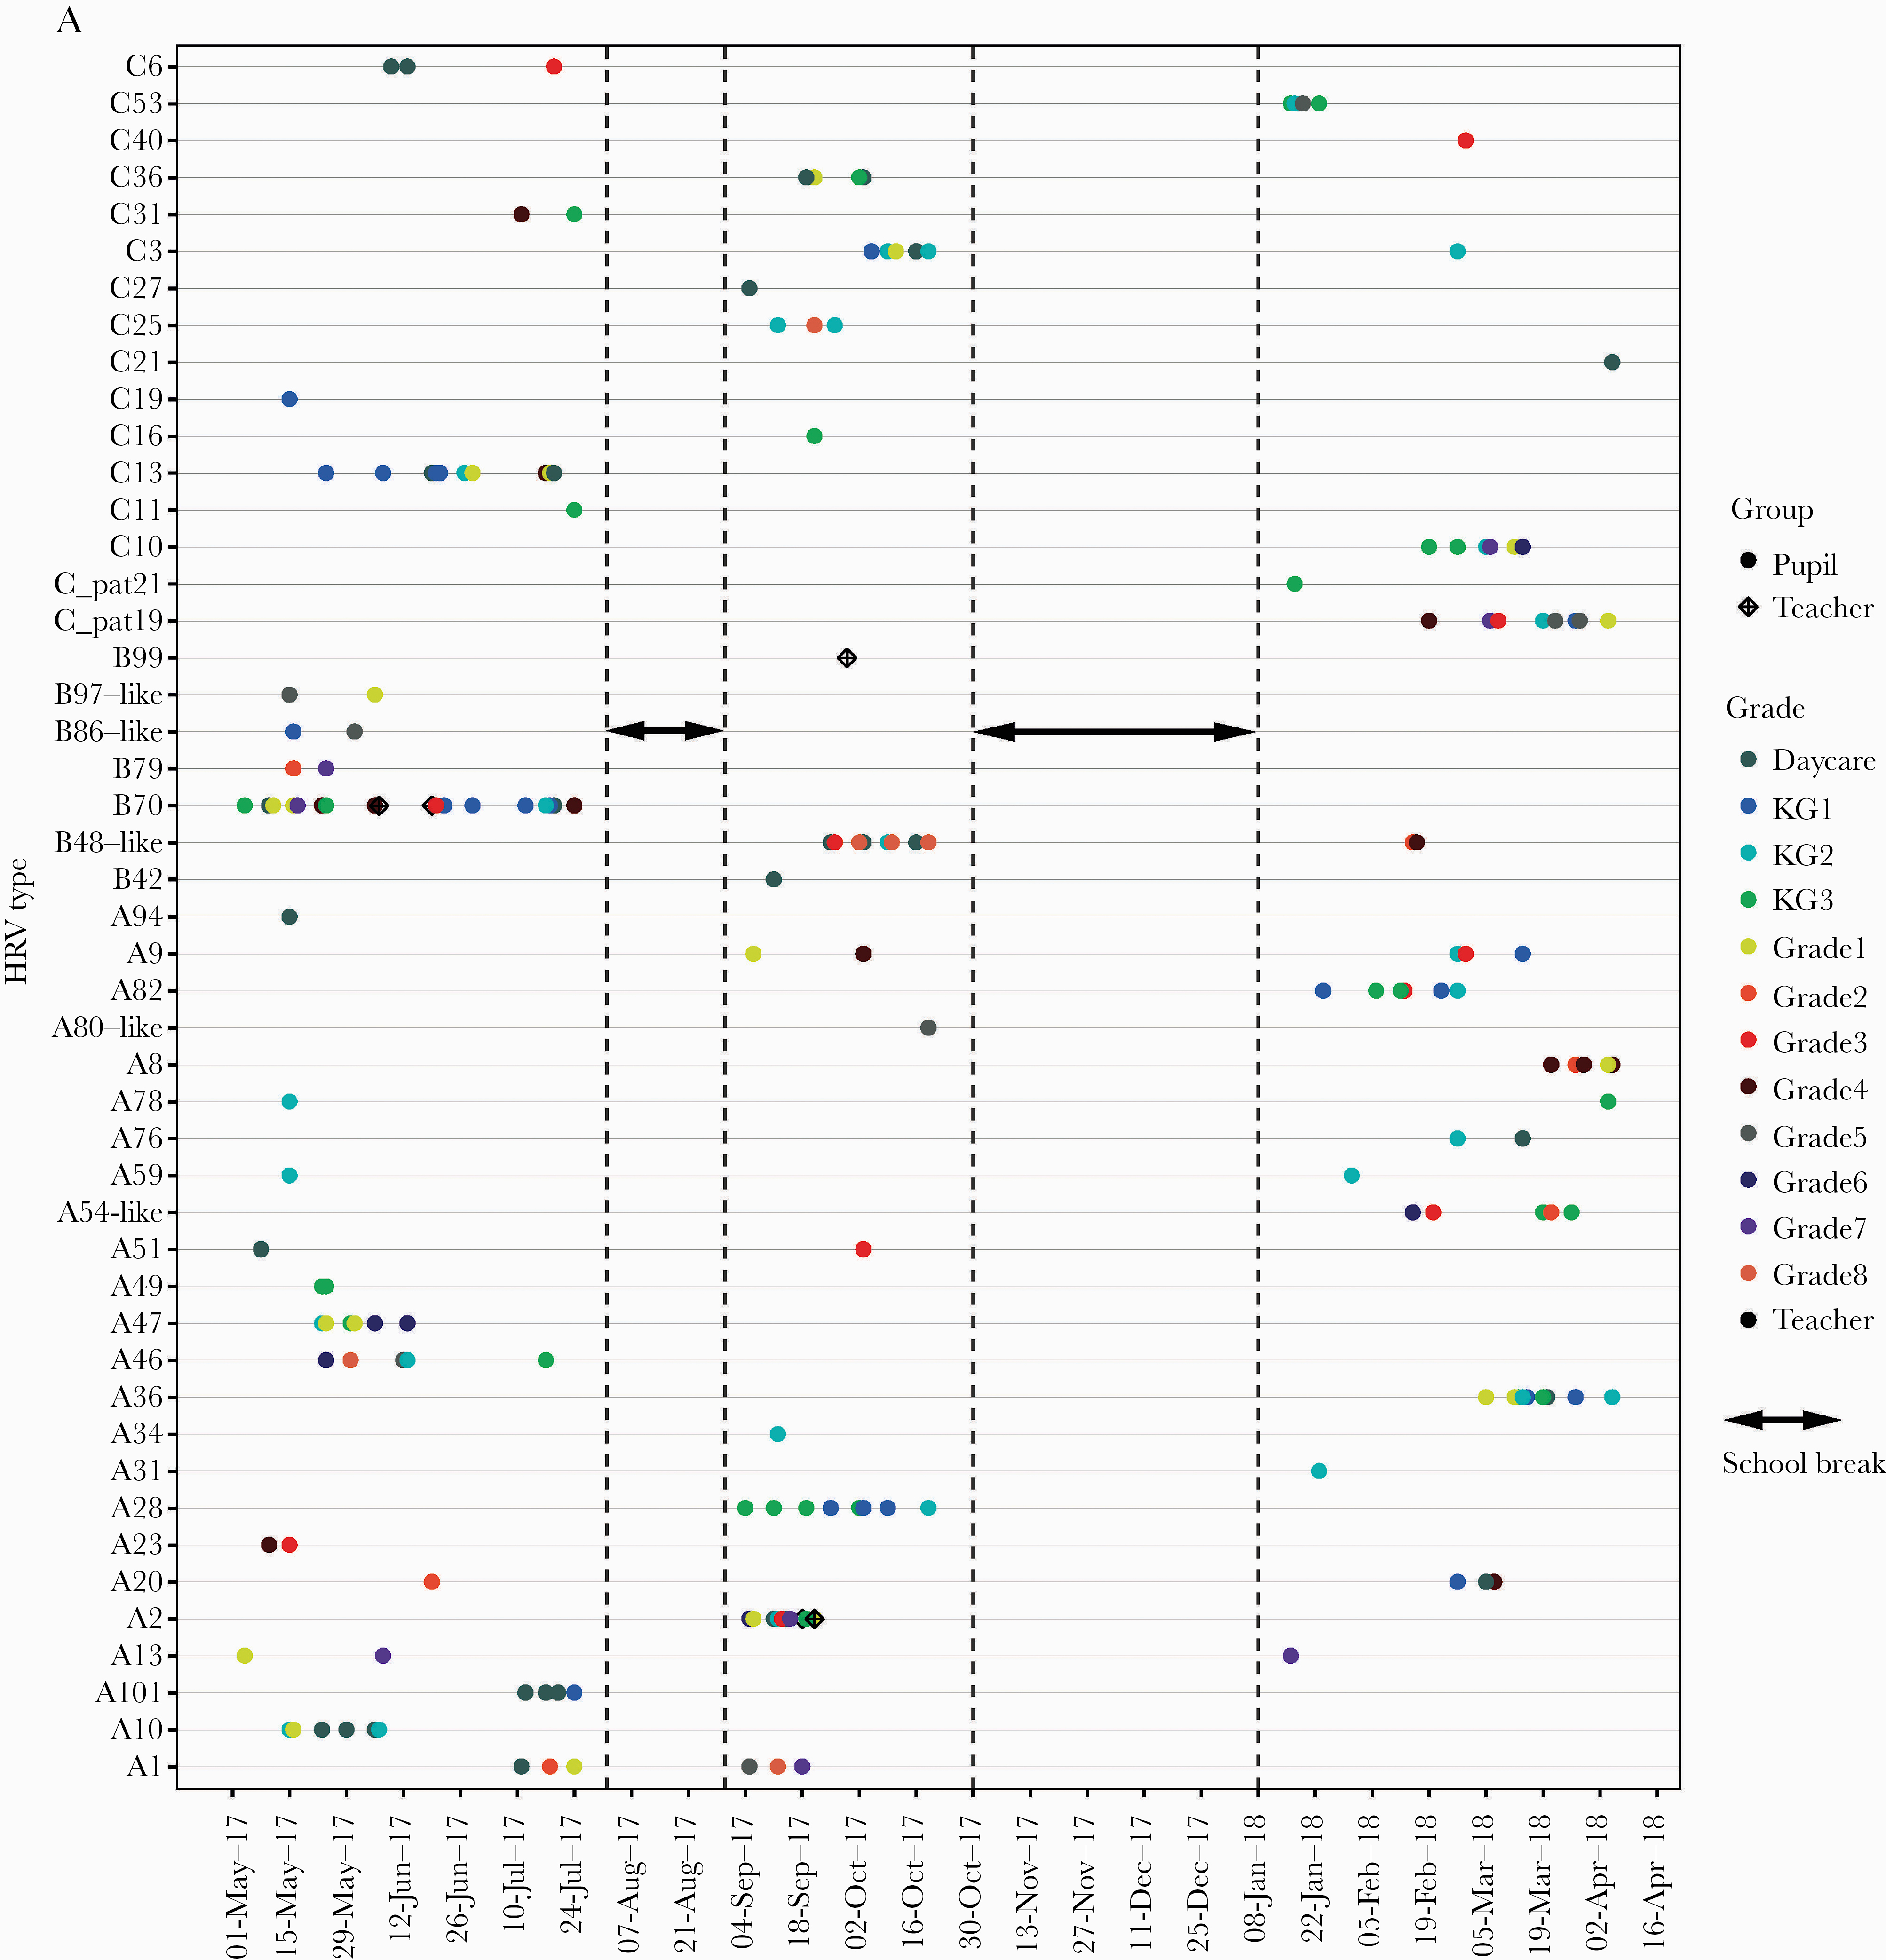
Visualisations
My route into R programming
ggplot
Luka et. al., 2020

Slide 10
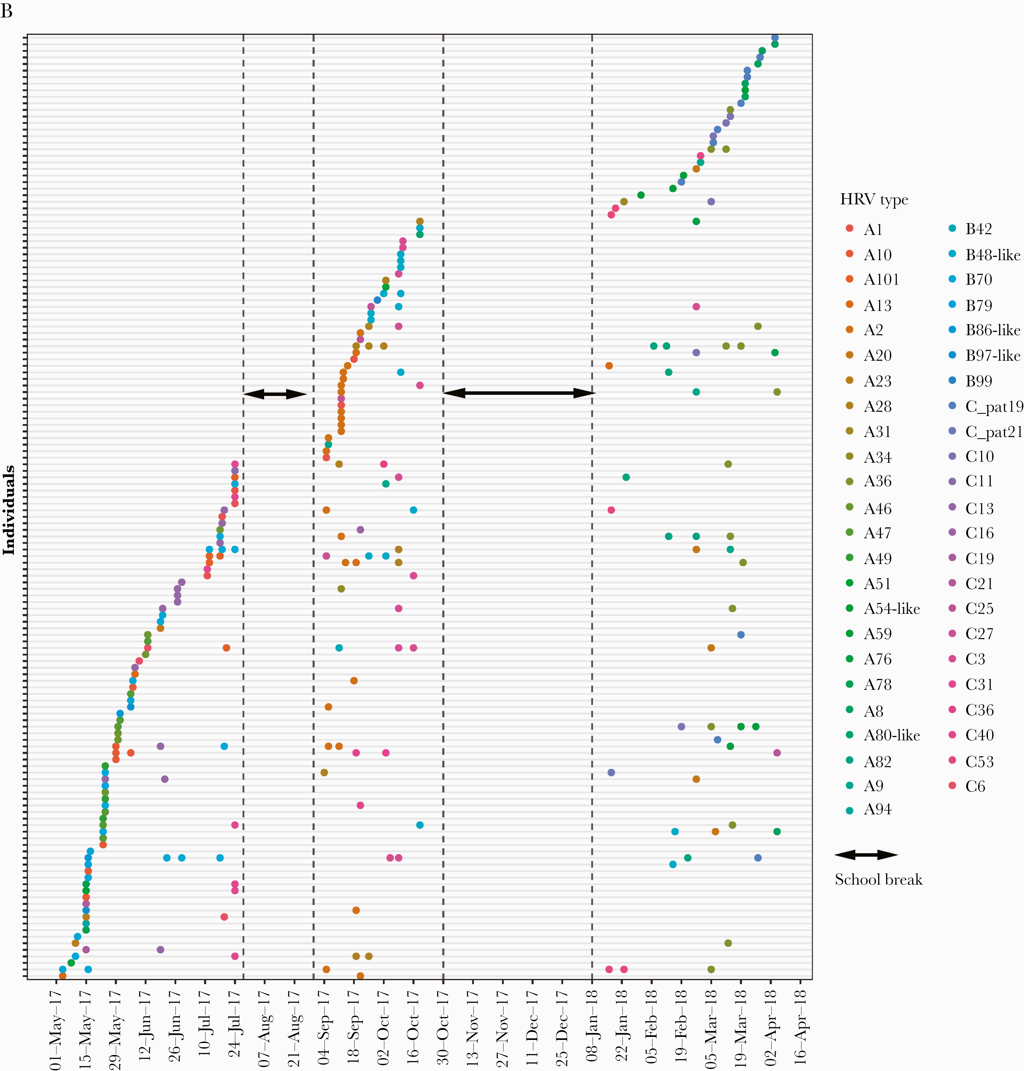

Visualisations
My route into R programming
ggplot
Barely understood what my lines of code did
Date
Sorting data
Copy and paste
Excitement of transforming data into plots through code, and colours!
If it works, don’t touch it…

Slide 11

Education
It was fascinating!
A prof who didn’t shy away from compliments
Interest in data (after the lab)
PgD. Health Research Methods,
Pwani University/KWTRP
Dec 2016
Aug 2018
Dec 2020
BSc. Medical Laboratory Science and Technology,
University of Nairobi
MSc. Bioinformatics,
Pwani University/KWTRP

Slide 12
Education
Msc Bioinformatics
The concept of programming
Translating my language to computer language
Then it all began to make sense (sometimes it still doesn’t)
RLadies Nairobi & R community openly sharing code

Slide 13
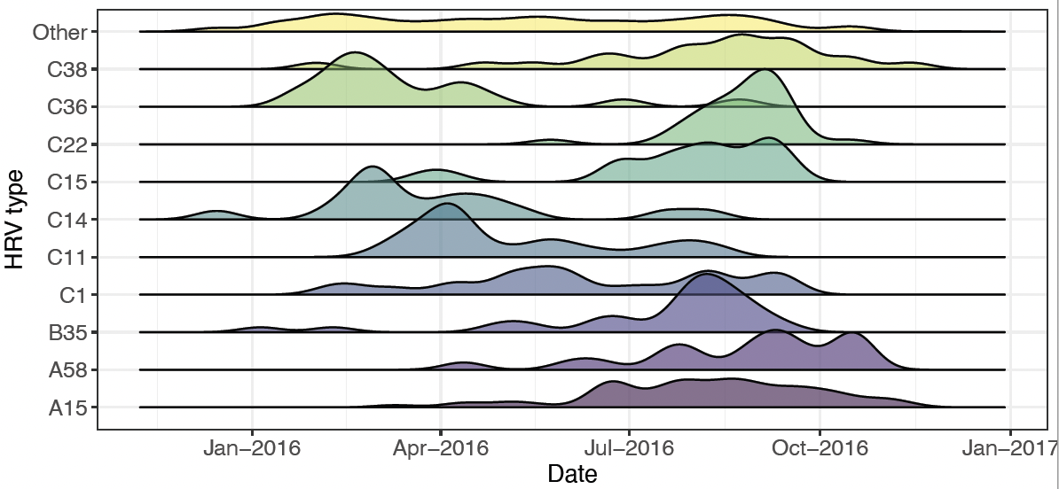
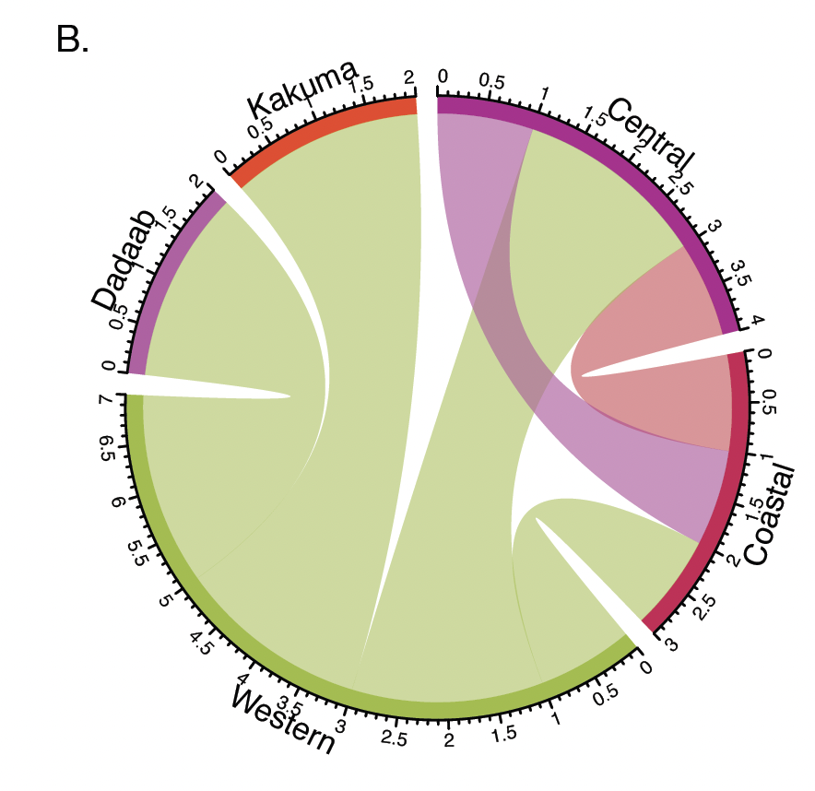

Education
Msc Bioinformatics
The concept of programming
Translating my language to computer language
Then it all began to make sense (sometimes it still doesn’t)
RLadies Nairobi & R community openly sharing code
..more cool visualizations…

Slide 14


New challenges
More to research than just visualizations
Quantitative data analysis, statistical models
Shiny dashboards
Statistics and math…
To my rescue
RLadies Nairobi
R4DS YT channel https://www.youtube.com/c/R4DSOnlineLearningCommunity/
R4DS book clubs
#TidyTuesday #30DayMapChallenge

Slide 15
Why R?
A wealth of tools (packages) to make life easier
Handle different file systems xml, fasta and vcf for biologists.
Geospatial maps.
And when it gets tough, packages to unwind (RKenya memes, dadjokes)
RCommunity
R working hard to become a one-stop shop

Slide 16

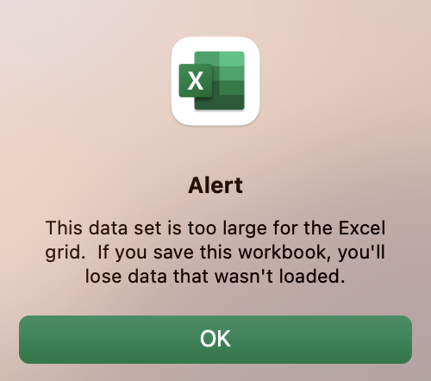
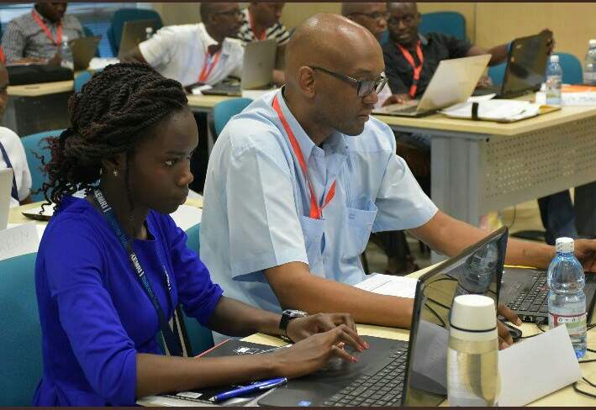


What did it take?
A supportive community - RLadies, R4DS
Real-world challenges
Self-drive
Training
Cheerleaders too

Slide 17
Thank you!

